Slide 1
Shared representations, practical adapters
A bounded test of PRH
and two engineering implementations
Experiment A Experiment B Shared hub
PRH = Platonic Representation Hypothesis · 20-minute talk
Liad Kashanovsky • AI Expert Project • September 2026
1
Notes:
0:00 – 0:30 (30 seconds)
My question began as an engineering problem: can independently developed models share a search system without retraining their encoders? I tested a bounded part of the Platonic Representation Hypothesis and built two systems from the result. I will follow the actual logic of the work: Experiment A on language representations, Experiment B on a phone-to-server adapter, and then the shared hub. The scientific conclusion concerns recoverable structure, especially local relationships. The engineering conclusion concerns useful interoperability under specific measured conditions.
Sources: Liad Kashanovsky • AI Expert Project • September 2026
Local source files refer to the uploaded project documents. Reported results have not been independently rerun for this presentation.

Slide 2
Research question and practical constraints
Scientific scope: shared relations and useful linear mappings on held-out items.
Practical constraint: limited compute and device memory favor frozen, smaller encoders.
Engineering - From science to engineering: MobileCLIP → SigLIP: reuse SigLIP’s stronger search space while a constrained device runs only MobileCLIP and a compact linear adapter.
The Hub: connect multiple image and text encoders through one shared coordinate system, allowing new encoders to reuse existing search heads after fitting only one lightweight entry map.
Supported scope: selected models, datasets and metrics. Universal convergence remains open.
Huh et al., ICML 2024; Final Project Report §§1–3, E.16
2
Notes:
0:30 – 1:00 (30 seconds)
PRH proposes that learned representations increasingly agree about the structure of the world, including across modalities. I narrowed this to testable questions: are relationships shared before fitting a map, can a simple fitted map recover them on held-out items, and can a downstream component reuse the result? Compute, memory and project time favored smaller pretrained encoders, cached embeddings and closed-form maps. The report specifies Google Colab with a T4 sufficient for the original A/B sequence. Cached vectors let later linear solves run on CPU. That makes controlled experiments feasible on modest hardware. It also matches the deployment goal: a phone should not need the server encoder. This is evidence about a subset of PRH, not proof of a universal representation.
Sources: Huh et al., ICML 2024; Final Project Report §§1–3, E.16
Local source files refer to the uploaded project documents. Reported results have not been independently rerun for this presentation.

Slide 3

Modality, objective and representation space
Modality = pixels or text
Objective = what training rewards
Embedding = numerical representation
Structure = relations among items
Shared structure means similar relationships among items.
Cat–dog diagrams are explanatory schematics, not measured embeddings.
Supplied cat–dog illustration; model cards; Project Atlas §1
3
Notes:
1:00 – 1:45 (45 seconds)
A modality is the kind of input, such as pixels or text. An objective is the learning task, such as next-token prediction or matching image-caption pairs. An encoder maps an input to a vector. Those numbers are coordinates in that encoder’s representation space. Structure means relationships among many items: which cats are near which dogs, and which are far from airplanes. Two encoders can preserve some relationships while using different coordinates. We therefore compare relational geometry or fit a map. Raw vectors from unrelated encoders are not directly comparable, and cosine is undefined when their dimensions differ.
Sources: Supplied cat–dog illustration; model cards; Project Atlas §1
Local source files refer to the uploaded project documents. Reported results have not been independently rerun for this presentation.

Slide 4
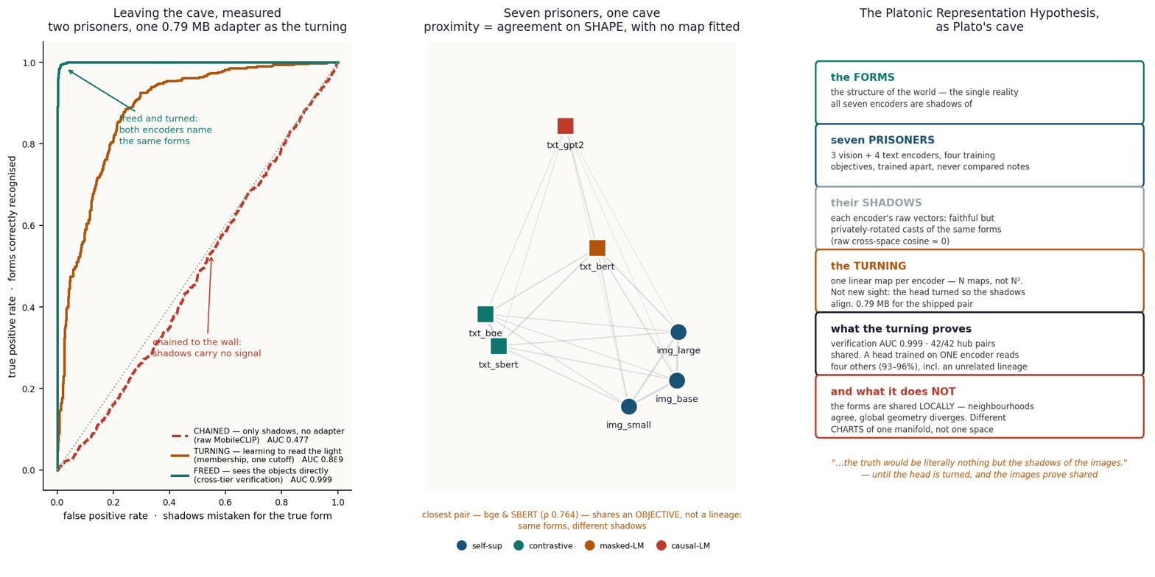

Slide 5
Similarity has several meanings
Measurement | Cat–dog question | Map fitted?
Cosine | Do these compatible vectors point alike? | No, or after mapping
Spearman ρ | Do both spaces rank item distances alike? | No
k-NN overlap | Does this cat have the same neighbors? | No
CKA / CKNNA | Do similarity patterns agree globally / locally? | No
Ridge / Procrustes | Does a full linear map / rotation recover targets? | Yes
CKA = centered kernel alignment. CKNNA measures alignment of mutual-neighbor structure.
Similarity_Methods_Master_Table.pdf; Report C.13
14
Notes:
12:15 – 13:00 (45 seconds)
A single similarity number cannot answer every scientific question. Cosine compares two vector directions within a compatible space. Spearman compares the ordering of distances computed separately inside two spaces. Neighborhood overlap asks whether the same nearby items appear in both lists. CKA compares centered similarity structures across a set of items. Ridge and Procrustes instead test what kind of fitted mapping succeeds. For a cat on a chair, agreement may mean another cat is nearby in both spaces even if its numeric coordinates differ. This motivates separating no-map geometry evidence from trained-map retrieval evidence and separating local agreement from global metric identity.
Sources: Similarity_Methods_Master_Table.pdf; Report C.13
Local source files refer to the uploaded project documents. Reported results have not been independently rerun for this presentation.

Slide 6
Data and what this project actually fits
Study | Data source | Fit / evaluation | Learned in this project
A | WikiText-103: Wikipedia | 7,500 / 2,500 passages | Layer-wise linear maps
B | COCO val2017 | 3,000 / 1,000 images | 512 × 768 adapter
F follow-up | Teacher image embeddings | 37,999 / 2,000 rows | Ridge and separate MLP
E-G Hub | COCO train2017 caches | 8,533 / 1,000 items | PCA, entry maps, caption head
B uses one caption per image. Hub targets average five caption embeddings.
Report §§3–4, C.9, E.10, E.15; Results Summary, cached vectors and splits
4
Notes:
1:45 – 2:45 (60 seconds)
WikiText-103 contains English Wikipedia passages. COCO supplies everyday photographs with human-written captions. The pretrained networks learned from their creators’ corpora. My datasets are used to extract representations and fit or evaluate mappings; I did not pretrain those encoders. Experiment A uses WikiText-103 passages. Experiment B uses COCO val2017 with one caption per image. The hub uses aligned COCO image rows with five caption embeddings averaged into one text anchor. All transforms must be fitted using training rows only. Closed-form ridge is still supervised fitting, even though it has no gradient loop. Distillation follow-ups train a separate head on teacher targets. They do not modify the pretrained backbone unless the gated unfreezing experiment is run.
Sources: Report §§3–4, C.9, E.10, E.15; Results Summary, cached vectors and splits
Local source files refer to the uploaded project documents. Reported results have not been independently rerun for this presentation.

Slide 7
Experiment A: independent language models
Same WikiText passage
GPT-2 · 124M
WebText
Pythia · 160M
The Pile
Random Pythia
control
13 states per model, each pooled to 768 coordinates
CKA (centered kernel alignment) compares relational structure. Ridge predicts coordinates.
Report §3; GPT-2 and Pythia model provenance
5
Notes:
2:45 – 3:45 (60 seconds)
Experiment A compares GPT-2, about 124 million parameters, and Pythia-160M. Both predict the next token, but they come from different model families and pretraining corpora. Each passage goes through both frozen models. Masked mean pooling yields one 768-dimensional vector per layer. A random-weight Pythia control keeps the architecture and input while removing learned weights. CKA asks whether the relational patterns agree; ridge stitching asks how much target variance a linear map predicts on held-out passages. Shared objective and overlapping real-world knowledge remain part of the scope; different labs do not prove that all pretraining content was disjoint.
Sources: Report §3; GPT-2 and Pythia model provenance
Local source files refer to the uploaded project documents. Reported results have not been independently rerun for this presentation.

Slide 8

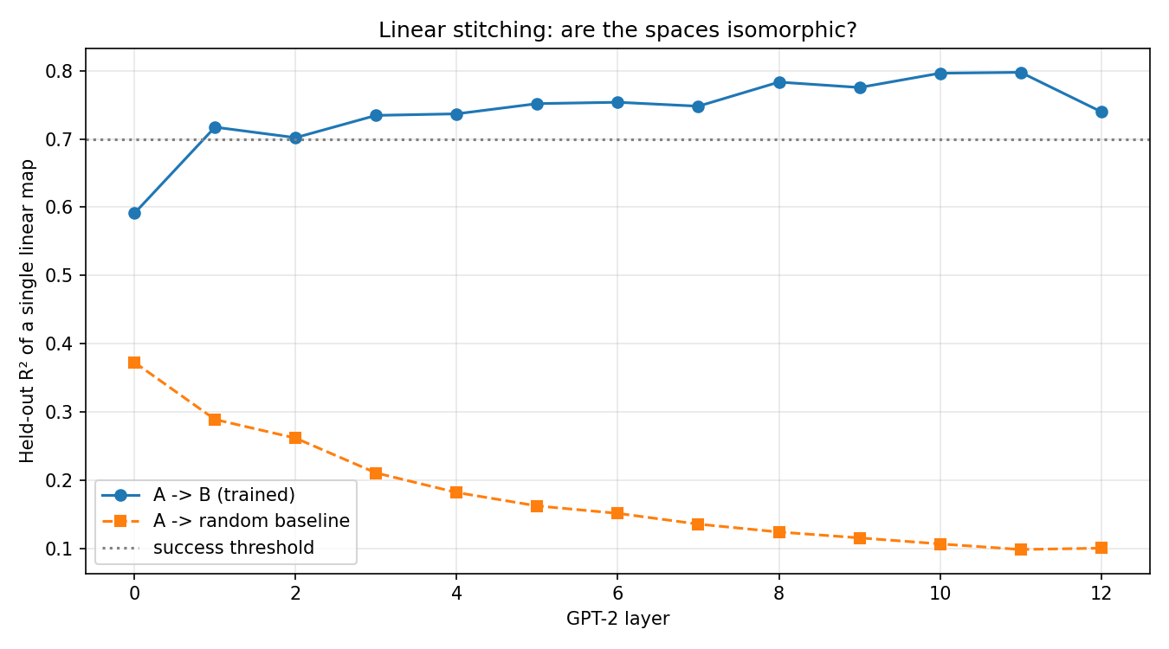
EXPERIMENT A · TWO LANGUAGE MODELS
Do GPT-2 and Pythia-160M carry the same information, layer by layer?
Data & setup
Data: 10,000 WikiText passages through both frozen models. Hidden states masked-mean-pooled per layer → A_layers [13, 10000, 768]. Per layer: CKA (structure) and one ridge map GPT-2→Pythia (stitching), with a seeded random-weights Pythia as control. 7,500 train / 768 = 9.8 rows/dim. Nothing was trained.
Measured — CKA (structure agreement): trained 0.359 vs random 0.067 = 5.3× (diagonal mean 0.424 = 6.3×). Stitching R² (linear map GPT-2→Pythia): 0.797 at layer 11 vs 0.173 random.
Proved: convergence exists at all, across architectures and data — the licence for everything after. The trained curve RISES with depth (0.59→0.80) while the random control DECAYS (0.38→0.09): opposite slopes, an 8× gap at layer 11.
Failure caught → converted: a rank-one ‘hubness’ component carried 97% of the CKA matrix; dividing marginals out lifted the diagonal 0.98→1.16. Run 1 (1,646 rows) FAILED on starvation; run 2 (10,000) passed — same pipeline, more rows.
the short math
CKA(K,L) = HSIC(K,L) /
sqrt(HSIC(K,K) HSIC(L,L))
pool_i = sum_t h_t / T (pads out)
W_l = ridge(X_l -> Y_l) per layer
16

Slide 9
Experiment A: learned structure exceeds control
R² = 0.797
At L11, a linear map explains about 80% of target variance.
CKA: similarity-pattern agreement
Mean 0.359 trained
Mean 0.067 random
Measured alignment supports the restricted hypothesis on this model pair.
Report §3, Table 3; Status Report, A2/A3 diagnostic caveats
6
Notes:
3:45 – 5:00 (75 seconds)
The chart shows selected matched layers, not every layer. At layer eleven, held-out R squared reaches 0.797 for the trained pair versus 0.090 for the random control. R squared measures variance explained in the target representation, including magnitude. The full-matrix mean CKA is 0.359 versus 0.067 for the random comparison, so learned weights matter. The first small-sample run fell below the stitching target; increasing from 1646 usable passages to 10000 raised mean trained R squared from 0.434 to 0.737. Later diagnostics found global CKA dominated by shared components, so I do not claim a perfect one-to-one layer identity.
Sources: Report §3, Table 3; Status Report, A2/A3 diagnostic caveats
Local source files refer to the uploaded project documents. Reported results have not been independently rerun for this presentation.

Slide 10
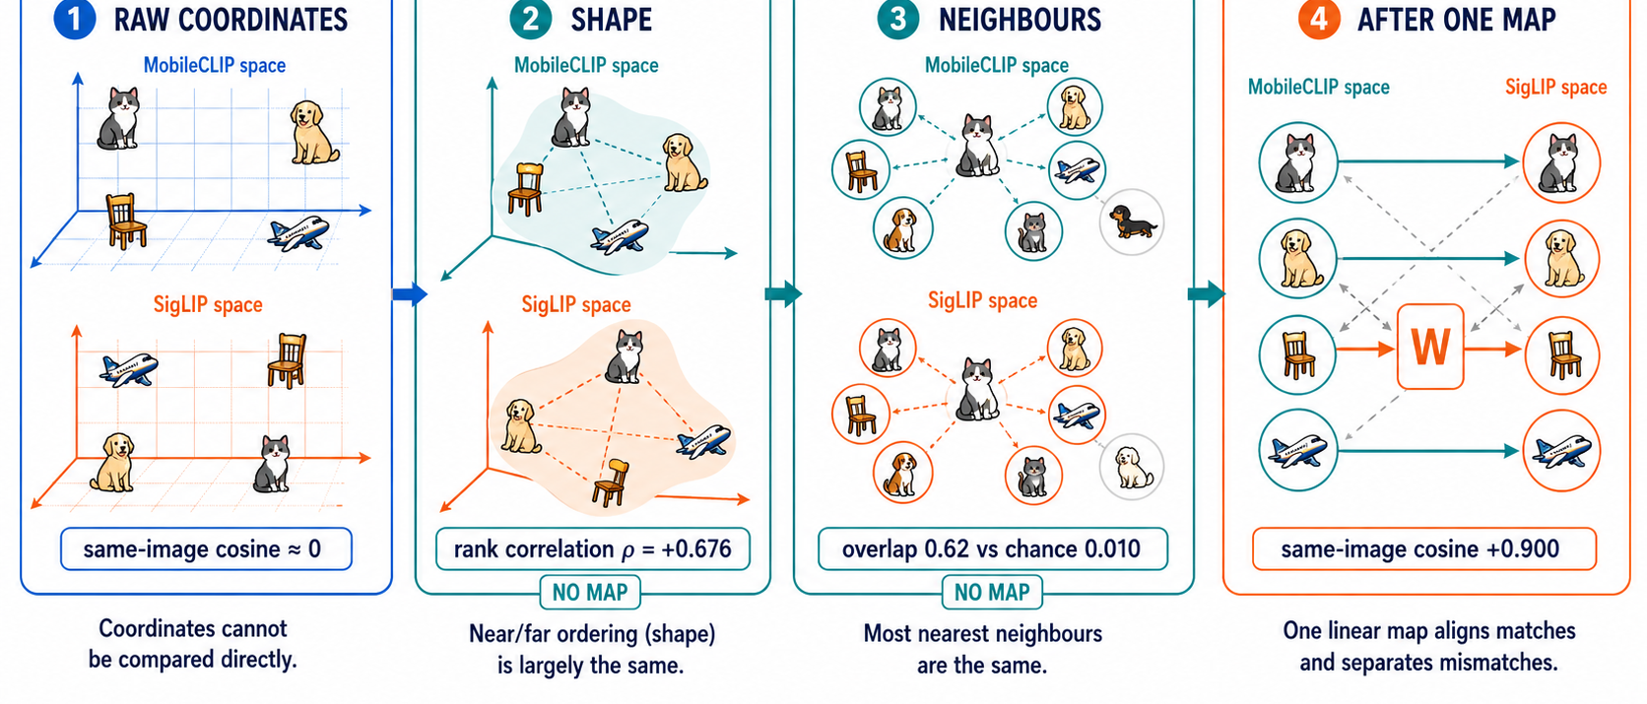
Report §3, Table 3; Status Report, A2/A3 diagnostic caveats
6
Notes:
3:45 – 5:00 (75 seconds)
The chart shows selected matched layers, not every layer. At layer eleven, held-out R squared reaches 0.797 for the trained pair versus 0.090 for the random control. R squared measures variance explained in the target representation, including magnitude. The full-matrix mean CKA is 0.359 versus 0.067 for the random comparison, so learned weights matter. The first small-sample run fell below the stitching target; increasing from 1646 usable passages to 10000 raised mean trained R squared from 0.434 to 0.737. Later diagnostics found global CKA dominated by shared components, so I do not claim a perfect one-to-one layer identity.
Sources: Report §3, Table 3; Status Report, A2/A3 diagnostic caveats
Local source files refer to the uploaded project documents. Reported results have not been independently rerun for this presentation.

Slide 11
Experiment B: one index for phone and server
Cat / dog photo
MobileCLIP-S1
512-vector × W
W: 512 × 768
Normalize
768-vector
Native SigLIP image
768-vector
One shared index
Query “a cat on a chair”: SigLIP text supplies the comparison vector.
Fit: 3,000 paired images. Test: 1,000 held-out images.
Report §4; MobileCLIP-S1 and SigLIP 2 model cards
7
Notes:
5:00 – 6:00 (60 seconds)
The first engineering system solves a concrete compatibility problem. The phone produces a 512-dimensional MobileCLIP image vector; the server search space uses 768-dimensional SigLIP 2 vectors. I fit one matrix on paired embeddings of the same training images, normalize its output, and index those adapted vectors alongside native SigLIP image vectors. Text queries use the native SigLIP text encoder. The adapter therefore translates image vectors between encoders. The overall search crosses modalities, but the fitted bridge itself is image-to-image. Only a compact adapter joins the phone model. Native encoders remain frozen.
Sources: Report §4; MobileCLIP-S1 and SigLIP 2 model cards
Local source files refer to the uploaded project documents. Reported results have not been independently rerun for this presentation.

Slide 12
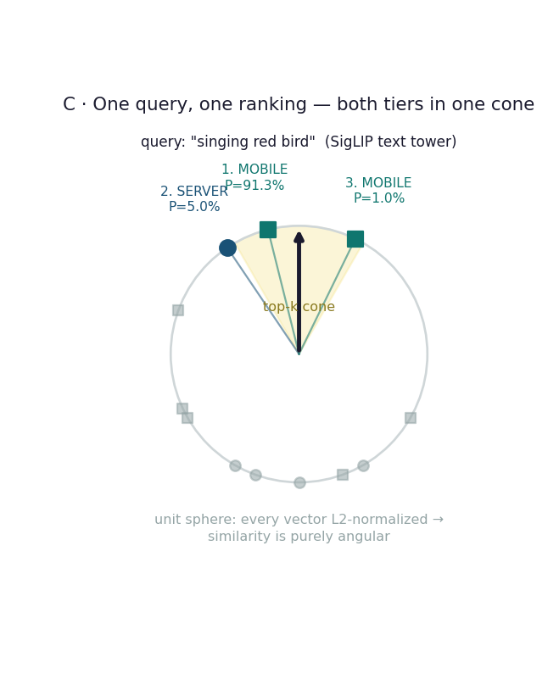
DEMONSTRATED
It runs — one query, both tiers, one ranking
Live demo, measured
1. MOBILE P = 91.3% the uploaded photo, indexed via the phone path
2. SERVER P = 5.0% goldfinches, indexed natively
3. MOBILE P = 1.0%
39 ms
0.08 ms
photo indexed on the
phone path, end to end
local search vs 150 ms
simulated network RTT
auto-captioned by BLIP
on upload
same math either way —
the network is the difference
Notes:
Honest scope: this is a qualitative demo on 9 vectors. The quantitative claim is B3's Recall@K on 1,000 held-out images.

Slide 13
Experiment B: retrieval quality and its cost
95.3%
of native R@5
0.843 / 0.885
R@1 retention: 88.4%
Below the 90% gate
R@5: the matching image appears among the first five results.
Report §4, Tables 4–5; 1,000 candidates, one-caption query protocol
8
Notes:
6:00 – 7:15 (75 seconds)
Recall at K is the fraction of queries for which the correct image appears in the first K results. The linear adapter reaches 0.557 at one, 0.843 at five, and 0.918 at ten. The native SigLIP comparison is 0.630, 0.885 and 0.944. Dividing gives 88.4, 95.3 and 97.2 percent retention. Thus the results-grid use case is stronger than the exact top-one use case. The top-one gate of ninety percent retention was missed. The raw no-adapter condition remains at chance. The numeric vector fit has R squared 0.592 and cosine 0.900; these measure different aspects and are not contradictory.
Sources: Report §4, Tables 4–5; 1,000 candidates, one-caption query protocol
Local source files refer to the uploaded project documents. Reported results have not been independently rerun for this presentation.

Slide 14
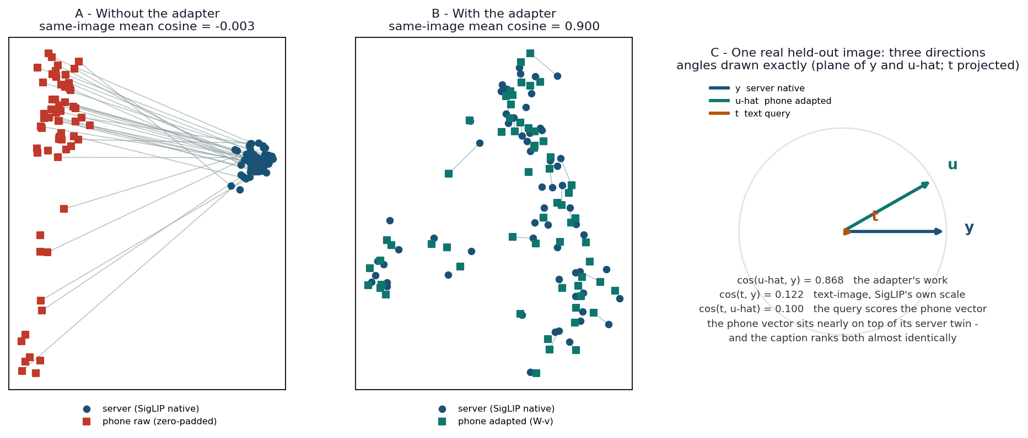
Report §3, Table 3; Status Report, A2/A3 diagnostic caveats
6
Notes:
3:45 – 5:00 (75 seconds)
The chart shows selected matched layers, not every layer. At layer eleven, held-out R squared reaches 0.797 for the trained pair versus 0.090 for the random control. R squared measures variance explained in the target representation, including magnitude. The full-matrix mean CKA is 0.359 versus 0.067 for the random comparison, so learned weights matter. The first small-sample run fell below the stitching target; increasing from 1646 usable passages to 10000 raised mean trained R squared from 0.434 to 0.737. Later diagnostics found global CKA dominated by shared components, so I do not claim a perfect one-to-one layer identity.
Sources: Report §3, Table 3; Status Report, A2/A3 diagnostic caveats
Local source files refer to the uploaded project documents. Reported results have not been independently rerun for this presentation.

Slide 15
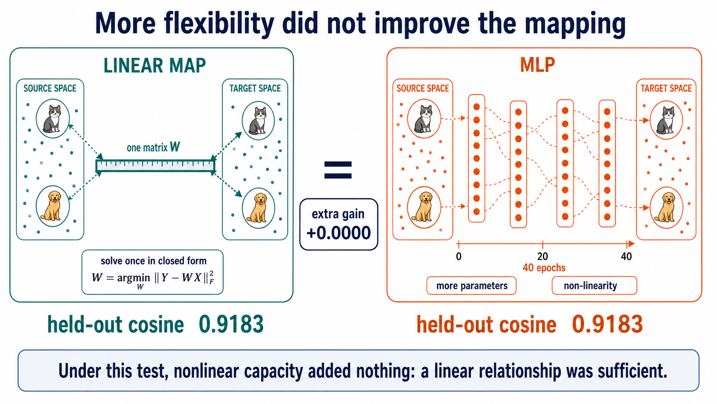

Slide 16
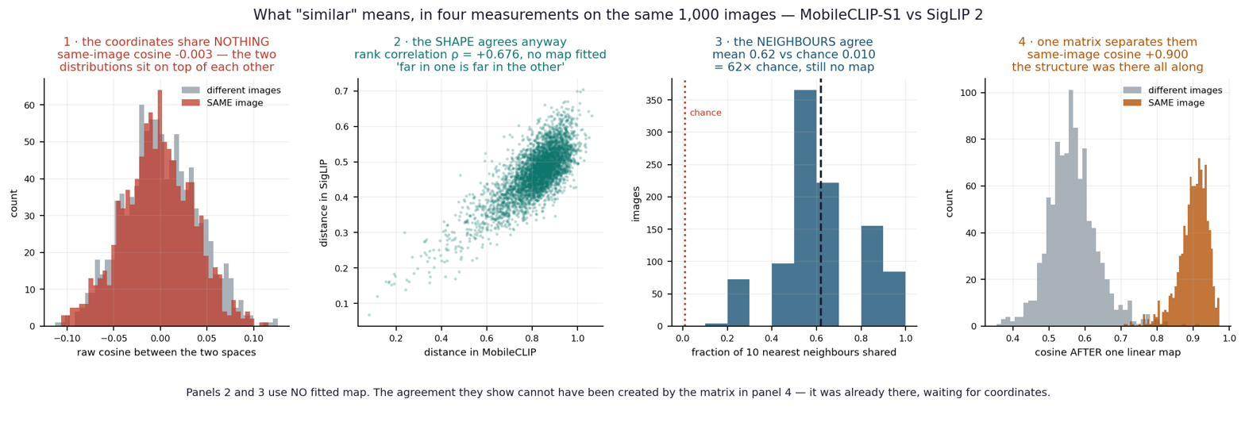
THE CENTRAL DISCOVERY
What is shared is LOCAL structure, not global geometry
The finding, on three metrics
Why it matters
Raw cosine ≈ 0 — coordinates never agree. But shapes do: distance-rank ρ +0.681, and 67% of an item's 10 nearest neighbours are shared (27× chance). Agreement is strongest for near neighbours and decays to chance by k = 500 — confirmed on k-NN, CKNNA, and rank correlation, including the metric PRH's own authors designed.
It narrows the Platonic claim to its DEFENSIBLE form. Models do not build the same space — they build different CHARTS of one shared structure, like two map projections of the Earth that disagree on area but both keep Spain next to France. It also explains why one linear map reaches most, but not all, of the ceiling.
15
Notes:
[18:15] The headline discovery. 'Same world' means same LOCAL arrangement of meaning. The map-projection metaphor is the takeaway line.

Slide 17
Small adapter, measurable deployment advantages
0.79 MB fp16 adapter: 393,216 coefficients; one matrix multiply plus normalization.
MobileCLIP-S1 vision tower: 21.5M parameters. Small enough to target constrained devices.
Core ML export and shared Qdrant index: reuse one search space across device tiers.
Cosine measures direction agreement: MLP 0.903 versus ridge 0.900. Little measured gain.
Reported prototype timings are not device-wide latency, battery or privacy guarantees.
Report §§4.4–4.6; Results Summary, F1–F5; Apple MobileCLIP repository
9
Notes:
7:15 – 8:00 (45 seconds)
The package contains 512 times 768 coefficients. At two bytes per coefficient, that is 786432 bytes, about 0.79 decimal megabytes, plus minor packaging overhead. Its computation is a matrix multiplication and normalization. The small vision encoder still has a real inference cost; the map does not make that free. The reported prototype supports local indexing while sending embeddings rather than raw photos to the shared system. I do not treat embeddings as a privacy guarantee. The demo reports 39 milliseconds for its path and a simulated network comparison, not a controlled phone battery benchmark. MLP controls found no meaningful gain; that supports this design choice without proving every possible nonlinear model would fail.
Sources: Report §§4.4–4.6; Results Summary, F1–F5; Apple MobileCLIP repository
Local source files refer to the uploaded project documents. Reported results have not been independently rerun for this presentation.

Slide 18
Cross-modal test before the hub
Image: DINOv2 representation. Text: bge representation of matching captions.
Fit paired vectors with ridge while both pretrained encoders stay frozen.
R@1 = 0.358: the correct target ranks first for 35.8% of 1,000 test queries.
40.9% of matched reference
0.358 / 0.875. Five-caption averaging applies to both method and reference.
Report C.9 and E-series; E1 single-caption versus five-caption treatment
10
Notes:
8:00 – 8:45 (45 seconds)
The next scientific step separates the modalities more strongly. DINOv2 learned visual representations without caption supervision in its loss. bge is a text retrieval encoder. I pair their outputs by COCO image identity and fit a linear map. This adds supervised correspondence at the mapping stage even though neither pretrained model changes. For the original DINOv2-base condition using its 768-dimensional CLS feature, absolute Recall at one is 0.358 among one thousand candidates. The matched SigLIP reference is 0.875, giving 40.9 percent of that reference. The result supports a usable but incomplete relationship across modalities. It is distinct from Experiment A and from the later shared-hub transfer scores.
Sources: Report C.9 and E-series; E1 single-caption versus five-caption treatment
Local source files refer to the uploaded project documents. Reported results have not been independently rerun for this presentation.

Slide 19
Engineering system 2: the shared hub
Configuration | Members defining the basis | Concat width
Published 4-space | DINO small/base/large + bge | 5,376
Intermediate 5-space | Four-space + GPT-2 | 6,144
Extended 7-space | Five-space + BERT + SBERT | 7,680
Scale each space · concatenate · PCA to 512 · whiten
Reference H comes from the fitted construction. Entry maps then learn to predict H.
Report C.13 and E.14; published 4-space, intermediate 5-space, extended 7-space
11
Notes:
8:45 – 10:00 (75 seconds)
The second engineering system creates a common 512-dimensional coordinate system. First collect embeddings for the same fitting items. The later protocol audit specifies one scalar rescaling per space, followed by concatenation, PCA truncation, and whitening of retained directions. This corrects earlier shorthand that implied independent z-scoring of every column. The published four-space hub concatenates three DINO encoders and bge for 5376 dimensions. The intermediate five-space version adds GPT-2; seven spaces also add BERT and SBERT. A member helps define the hub basis. An encoder added later can simply receive an entry map. These are different operations.
Sources: Report C.13 and E.14; published 4-space, intermediate 5-space, extended 7-space
Local source files refer to the uploaded project documents. Reported results have not been independently rerun for this presentation.

Slide 20
Training references and prediction routes
Fit | Input | Training reference / target
Hub basis | Aligned member embeddings | Data-derived PCA coordinates H
Entry map W_k | Encoder features X_k | Reference hub coordinates H
Caption head W_head | H_small = X_small W_small | Actual bge caption vectors T_bge
At prediction time
Cat image vector
W_k
Predicted hub
W_head
Predicted bge
Rank captions
cat / dog / others
Report C.13; Frozen_Hub_Caption_Transfer_Corrected.pdf
12
Notes:
10:00 – 11:15 (75 seconds)
There are three distinct fitted components. Hub construction defines H. Each entry map learns X_k W_k approximately H. Then the caption head learns from H_small, which is DINO-small’s predicted hub coordinates, to actual bge caption embeddings. H and H_small have the same coordinate frame but need not have identical values. During a query, run only the selected encoder, its entry map and the output head. A cat image produces a predicted bge vector and cosine ranking retrieves a caption. The caption head was trained on DINO-small’s route; its usefulness through another route is an empirical transfer result. The hub is not divided into encoder-specific compartments.
Sources: Report C.13; Frozen_Hub_Caption_Transfer_Corrected.pdf
Local source files refer to the uploaded project documents. Reported results have not been independently rerun for this presentation.

Slide 21
A frozen head transfers to new encoders
ConvNeXt: 96.7%
One new entry map.
Same frozen hub.
Same frozen caption head.
Retention measures reusable-head performance relative to an encoder-specific head.
Hub Scores Summary, published column; Report E.2 and G0-exact
13
Notes:
11:15 – 12:15 (60 seconds)
A held-out encoder did not define the hub or train the caption head. For ConvNeXt, fit one entry map from its training-item embeddings to the existing H, then reuse the frozen head. The reported published retention is 96.7 percent of a head fitted for ConvNeXt itself. This is not 96.7 percent retrieval accuracy. SigLIP retains 94.2 percent and supplies a separate lineage test. ConvNeXt changes architecture and supervision regime, although the broader objective and corpus factors remain confounded. Zero-shot refers to the head transfer, not to zero data for fitting the new entry map. The rebuilt protocol gives different levels and stays separate.
Sources: Hub Scores Summary, published column; Report E.2 and G0-exact
Local source files refer to the uploaded project documents. Reported results have not been independently rerun for this presentation.

Slide 22
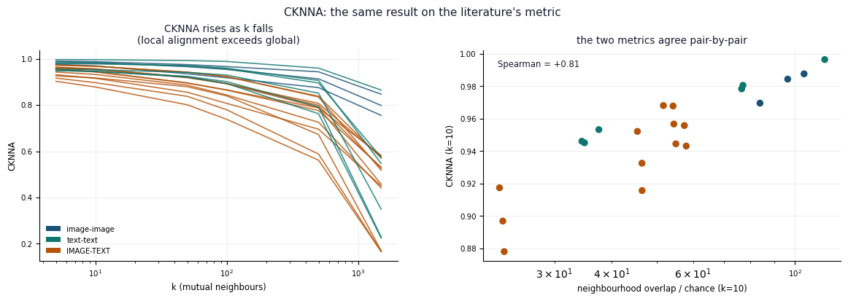
The strongest shared structure is local
21 / 21 pairs: local CKNNA exceeds the global limit
CKNNA compares local similarity structure. The falling overlap/chance curve alone is insufficient.
Report C.13.8–C.13.10; supplied CKNNA.png
15
Notes:
13:00 – 14:15 (75 seconds)
This is the principal geometry result. CKNNA restricts a centered alignment calculation to mutual nearest-neighbor relationships. Across the seven-encoder comparisons, all twenty-one unordered pairs score higher locally than at the global limit. The supplied figure also compares this literature metric with the project’s neighborhood measure, giving a Spearman pair-ranking correlation of 0.81. That correlation measures agreement between the two diagnostics, not direct encoder alignment. I avoid using the descending overlap-to-chance curve as the proof, because its maximum already shrinks with neighborhood size. The evidence supports shared local relations on these samples. It does not establish one universal globally identical manifold.
Sources: Report C.13.8–C.13.10; supplied CKNNA.png
Local source files refer to the uploaded project documents. Reported results have not been independently rerun for this presentation.

Slide 23
GPT-2 separates reading from writing
Space | Read out | Write into | Interpretation
GPT-2 | 95.1% | 24.8% | Recoverable content, fragile target ranking
bge-m3 | 98.1%* | 98.1% | Useful caption target
SBERT | Not supplied | 101.0% | Relative target score, not accuracy
Read: source vector into hub. Write: hub prediction into a target space.
*bge read figure comes from the supplied discussion; diagnostics use their own references.
Report C.13.3–C.13.4, C.11; supplied read/write diagnostics
16
Notes:
14:15 – 15:00 (45 seconds)
Readable means a fitted map can extract useful information from a source space. Writable means prediction into the target space supports the intended ranking. GPT-2 reaches 95.1 percent in the source diagnostic but only 24.8 percent as a target. These are normalized diagnostic scores, not accuracy. Its average pair cosine is near 0.999, so very small differences determine rankings. bge and SBERT work much better as targets under the reported protocol. The full-rank GPT-2 whitening experiment improves retrieval, but hub PCA whitening is a different operation. The comparison is an explanation of the directional failure, not a claim that GPT-2 can never support retrieval.
Sources: Report C.13.3–C.13.4, C.11; supplied read/write diagnostics
Local source files refer to the uploaded project documents. Reported results have not been independently rerun for this presentation.

Slide 24
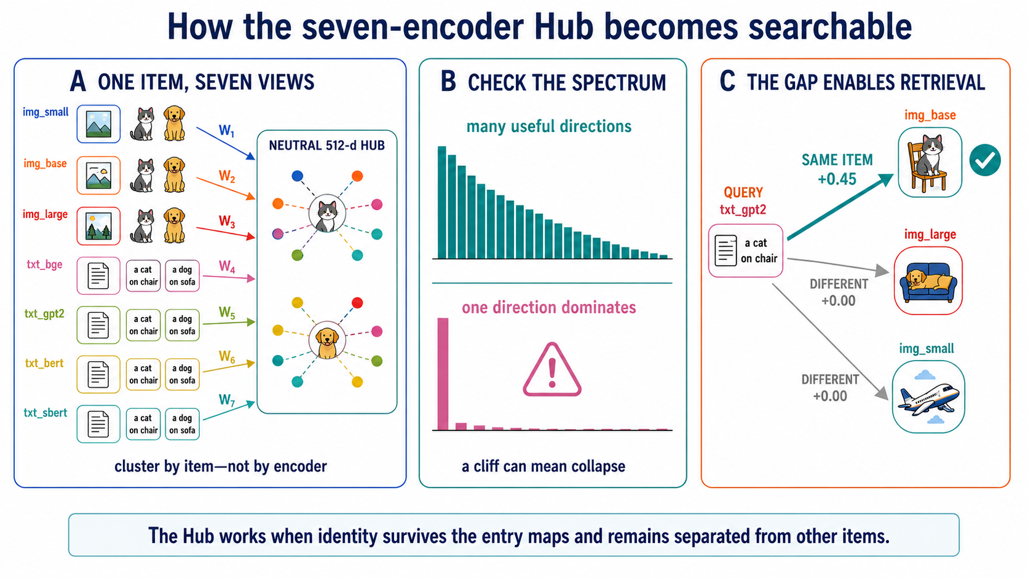

Slide 25
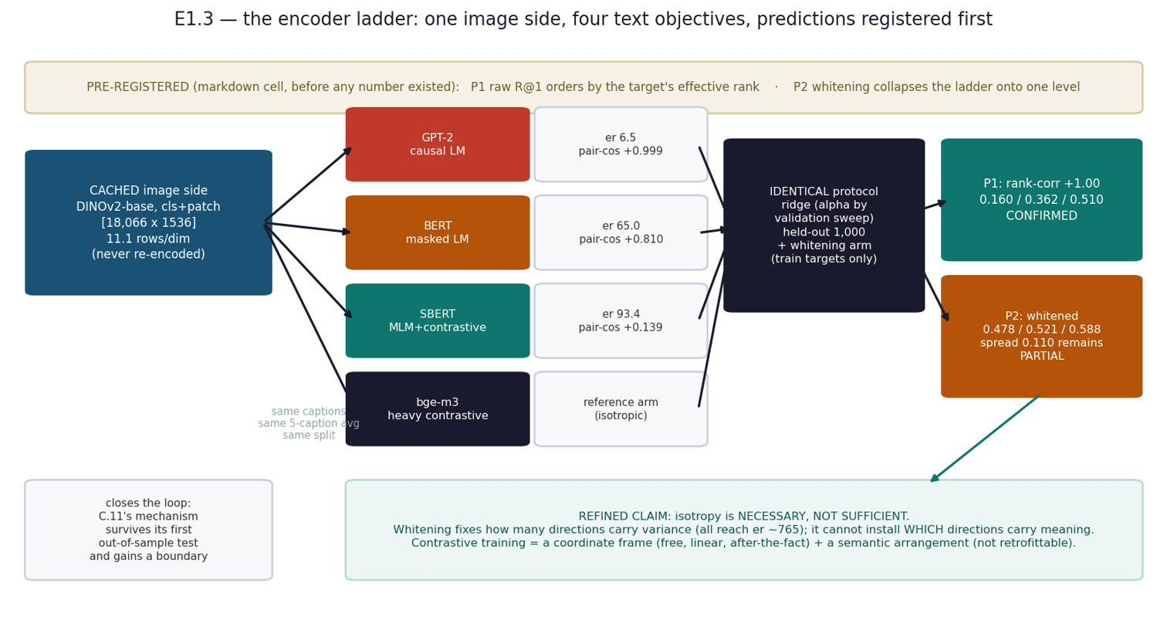
DISCOVERY · ISOTROPY, NOT SIMILARITY-TRAINING
A collapsed language space, rescued to 102.6% of a contrastive encoder by a free linear transform
What happened
GPT-2's caption space has effective rank 6.6 of 768 — every caption sits at cosine +0.999 to every other. A cone, not a cloud. Cosine reads 1.000 while retrieval R@1 is 0.130.
Whitening (divide each direction by its spread — label-free, linear) lifts R@1 to 0.478 = 102.6% of an encoder trained contrastively on 1.2 BILLION pairs. The information was there; the geometry hid it.
CONTROL: centering alone (no whitening) leaves rank at 6.5 and fails — so it is the isotropy, not the shift.
Measured — effective rank vs R@1 correlate at ρ +0.94 across encoders: isotropy is a dial, not a switch.
Proved: isotropy is NECESSARY, not sufficient — a linear transform supplies the coordinate frame; contrastive training adds the arrangement that survives whitening.
13
Notes:
[15:45] A discovery, not a planned result. The rescue number (102.6% of a billion-pair model, for free) is the memorable one. Centering-alone is the control that isolates isotropy.

Slide 26
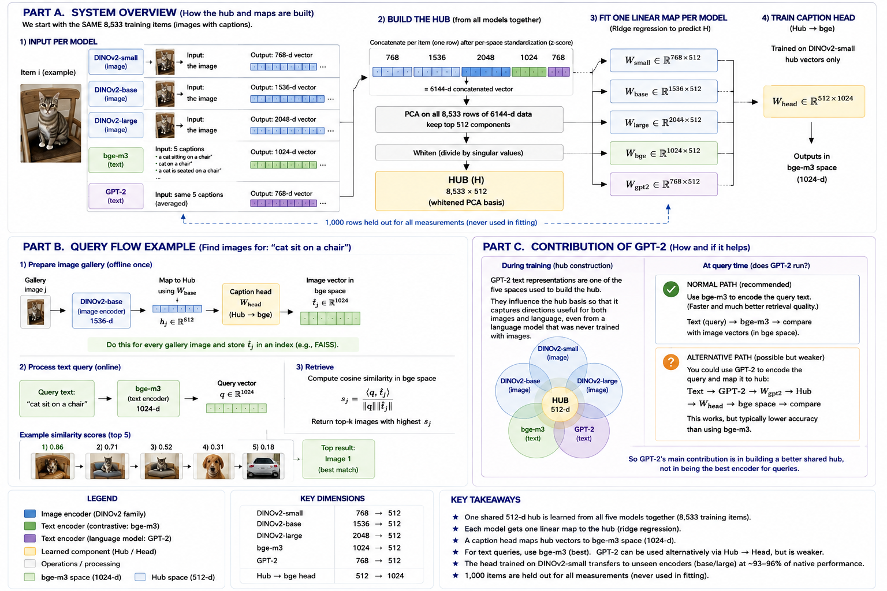
THE HUB · MANY ENCODERS, ONE SPACE
▶ LIVE DEMO
A component trained on ONE encoder transfers to encoders it never saw
recipient (never seen) | R@1 | % native | control
DINOv2-base (sibling) | 0.445 | 96.5%
SigLIP 2 (new lineage) | 0.557 | 94.2% | held-out
ConvNeXt (convnet, supervised) | — | 96.7% | held-out
random-map control | 0.003 | — | chance 0.001
Build once (no training): z-score → concatenate → PCA to 512 → whiten. One ridge map per encoder INTO the hub; one caption head OUT. Adding a model = ONE solve; hub, head, every other map untouched.
CONTROLS: a random entry map scores 0.003 (chance 0.001). ConvNeXt — a convnet, fully supervised, never a member — hits 96.7%, ABOVE the ViT band: neither architecture nor supervision bounds the claim.
All 42 directed pairs share one hub at 103.6% of per-pair hubs — sharing is free.
▶ Demo notebook G2 (live) — Drive: convergence_experiment
14
Notes:
[17:00] DEMO 2. Show G2: image or caption in, ranked results out, through the shared hub. The random-map control (0.003) and ConvNeXt held-out (96.7%) are the two numbers to say aloud.

Slide 27

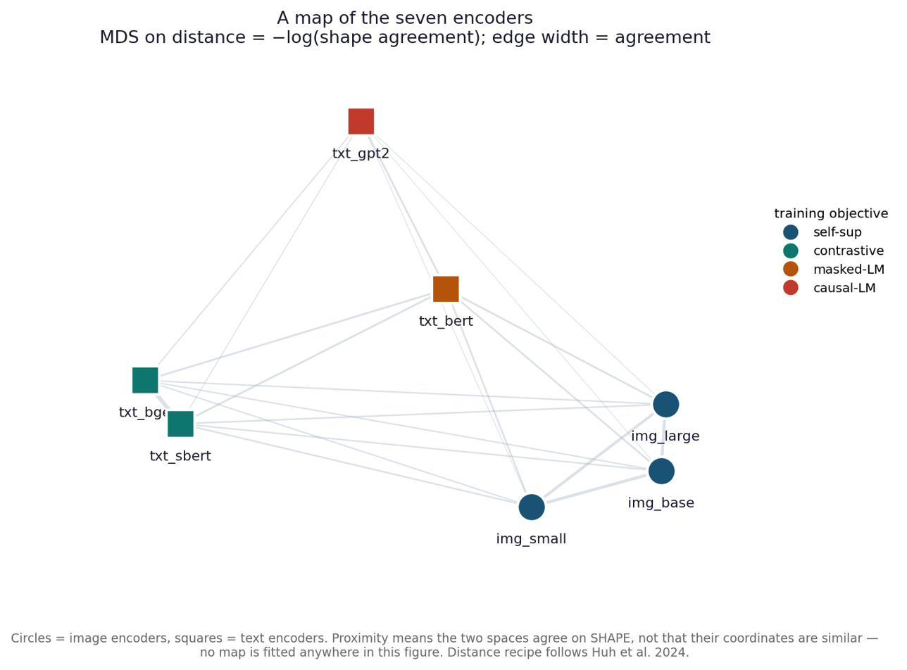
AND WHAT DECIDES HOW MUCH
Objective beats lineage beats modality
Top pair: bge–SBERT ρ +0.76 — shares an objective and NO ancestry; beats the sibling image pair.
ConvNeXt: LOWEST raw shape agreement (0.33–0.40), HIGHEST transfer (96.7%) — raw shape does not predict transfer.
MDS map (right): no map fitted — encoders cluster by training OBJECTIVE, not by modality.
+53×
+44×
+29×
shared OBJECTIVE
shared LINEAGE
shared MODALITY
16
Notes:
[19:00] The causal hint: what you train FOR matters more than what you train ON or which sense you use. bge-SBERT (shared objective, no ancestry) is the cleanest evidence.

Slide 28
ACHIEVEMENTS — AND THE HONESTY THAT BACKS THEM
Nine findings, two shipped systems, eleven falsified explanations
PROVED & BUILT
FALSIFIED, KEPT ON THE RECORD (11 — two of them mine)
Convergence is real but LOCAL; linear, not rigid (0.038 vs 0.592).
Cross-modal with no joint training: 40.9–58.3% of ceiling, 358× chance.
Isotropy rescue: a collapsed space → 102.6% of a billion-pair encoder.
Self-identifying from shape alone: 39.7% exact with ZERO pairs (595× chance).
Objective > lineage > modality (+53 / +44 / +29×).
Shipped: a 0.79 MB phone adapter, and a hub where adding a model is one solve.
'Same space' — refuted (raw cosine ≈ 0). It is local, not global.
'A rotation aligns them' — refuted (0.038). 'An MLP beats the matrix' — refuted (+0.0000).
'Scaling keeps helping' — refuted (both ladders fall past 304M).
The width cliff: transfer collapses at hub width = 768. Seven mechanisms falsified; the eighth confirmed — 768 is the source encoder's algebraic rank, a NUMERICAL artifact, not a property of sharing. One of my own tests was wrong and is recorded as such.
The method IS the result: a claim that survived a test which could have killed it is worth more than one never exposed to one.
Full method, all tables and the falsification ledger: Final_Project_Report.pdf (74 pp) · the story with the math: Project_Atlas.pdf
17
Notes:
[19:30] Land the achievements and the honesty in one breath. The falsification ledger, including my own errors, is the scientific-integrity signature of the project.

Slide 29
IN ONE PARAGRAPH
Two models never share coordinates — raw agreement is exactly chance. But they describe the same world, and the translation between them is a single matrix small enough to fit on a phone. What they share most strongly is LOCAL: they agree about what is near what, and diverge about the shape of the whole. The frame that makes structure readable is cheap; the arrangement of meaning across directions is what training actually buys.
NEXT, IN ORDER OF VALUE
1 · Scale the text side to 7B+ — the examiner's first question, and Qwen-4B already fell.
2 · K small experts vs one large model, at matched parameters (pre-registered B1).
3 · Re-estimate the hub on a 35k-item corpus; then rebuild it WITH DINOv2-giant as a member.
4 · Reverse-direction transfer (ConvNeXt as target) · other languages · non-linear hubs.
Science: a subset of PRH proved, narrowed to its defensible form. Engineering: two small-expert systems that run without a GPU. Method: 11 falsified explanations kept on the record.
Thank you — questions welcome.
Notes:
[20:00] Close. The one-paragraph summary is the sentence to leave them with. To-do slide doubles as the answer to 'what about big models?' — conceded and prioritised.

Slide 30
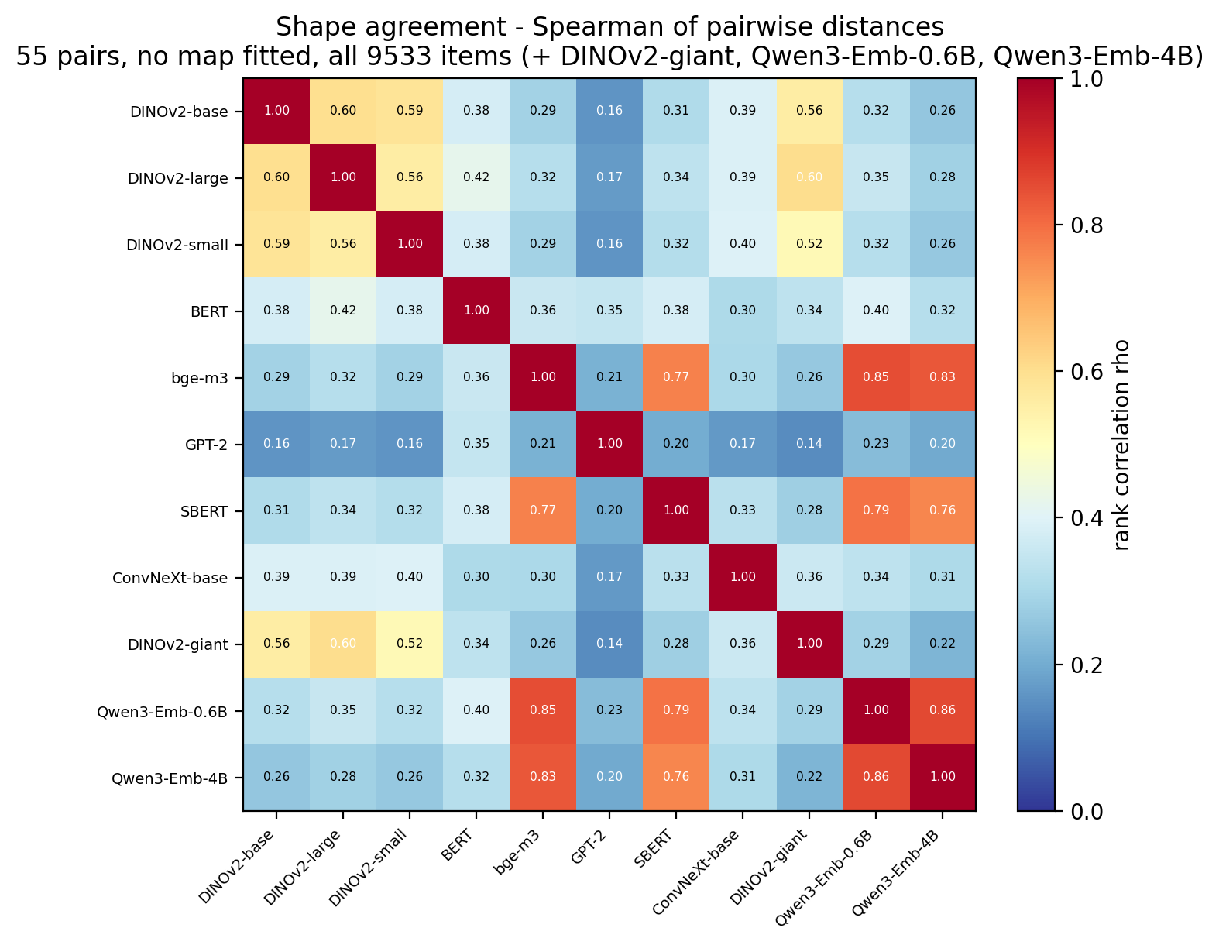

Slide 31
Larger-model tests: progress and limits
ρ ranks pairwise distances with no fitted map. Bigger did not mean higher agreement here.
Report E.16, Table C12s; supplied scale_ladder_rho.png
17
Notes:
15:00 – 16:00 (60 seconds)
The early small/base/large fitted-retrieval ladder improved. The later no-map geometry test asks a different question and extends to DINO giant and Qwen four billion. The best cross-modal Spearman values rise and then fall in both plotted ladders. DINO large has 0.418 and giant 0.339. Qwen 0.6B has 0.352 and Qwen 4B 0.307. These are best-pair statistics, so the counterpart can change. The findings reject the tested monotonic predictions at this scale, not the entire PRH. Giant’s fitted transfer score is inconclusive because the entry fit has only 2.8 rows per dimension. More paired data comes before interpreting that ratio.
Sources: Report E.16, Table C12s; supplied scale_ladder_rho.png
Local source files refer to the uploaded project documents. Reported results have not been independently rerun for this presentation.

Slide 32
Six controls and the numbers they guard
Control | Fitted result | Control / reference | What this checks
Random map / no adapter | AUC .999 G4 R@1 .557 | AUC .477 G4 R@1 .003 | The learned bridge supplies useful information.
Random model weights | Mean CKA .359 Mean R² .737 | Mean CKA .067 Mean R² .173 | Learned representations exceed the random-weight comparison.
Shuffle item pairing | E1 R² .511 | Shuffled R² −.130 Gap .641 | Correct item correspondence matters to the fitted map.
Matched native reference | B R@5 .843 | Native R@5 .885 95.3% retention | Task, rows and caption treatment must match.
Held-out ConvNeXt | R@1 retention 96.7% | ViT band 93.8–96.5% | Tests a supervised convnet outside the hub membership.
Held-out SigLIP 2 | R@1 retention 94.2% | Encoder-specific head | Tests an unrelated lineage with the caption head frozen.
R² explains target variance. AUC separates pairs. R@K counts successful retrievals.
Report §3, C.9, C.13.2, D.2, E.2; Results Summary(3)
18
Notes:
16:00 – 17:15 (75 seconds)
Each control tests a specific alternative explanation. First, removing the adapter lowers verification AUC from 0.999 to 0.477. In the same G4 lineage run, fitted-map retrieval R@1 is 0.557 versus 0.003 for a random entry map, near the 0.001 chance rate. The seven-space score of 0.451 belongs to another run, so it is not paired with G4’s 0.003 here. Second, use matched averages: full-matrix CKA 0.359 versus 0.067, and mean stitching R squared 0.737 versus 0.173. At layer eleven alone, the comparison is 0.797 versus 0.090. Third, shuffling E1 correspondence changes R squared from 0.511 to minus 0.130, a gap of 0.641. Fourth, the native reference uses the same task and rows. Finally, ConvNeXt and SigLIP test head transfer beyond the construction family. ConvNeXt’s 96.7 percent sits slightly above the 93.8–96.5 percent ViT band in that run, but this is not a statistical claim that convolution is superior.
Sources: Report §3, C.9, C.13.2, D.2, E.2; Results Summary(3)
Local source files refer to the uploaded project documents. Reported results have not been independently rerun for this presentation.

Slide 33
Failures sharpened the claims
Observation | Lesson / correction
A: initial fit underpowered | Increase paired rows before interpreting a failure.
B: MLP did not improve R@1 | A linear map was sufficient in the tested controls.
B: 88.4% retention at R@1 | Report the missed 90% gate.
Hub: width cliff | Near-null head-fit direction; regularization or truncation repairs it.
Metric traps | Ratios, geometry and chance need matched interpretation.
Report §§3–4, C.13.9, E.8, E.13–E.17
19
Notes:
17:15 – 17:45 (30 seconds)
Several negative results matter as much as the headline wins. Too few fitting rows initially understated language-model stitching. A nonlinear adapter did not improve the measured task meaningfully. The top-one retrieval gate remained missed. The hub-width cliff initially looked like a scientific limit; follow-up experiments traced it to an unstable near-null direction in the caption-head fit, and truncation or stronger head regularization repaired it. Finally, ratio metrics and shrinking chance-normalized bounds can mislead. I retain the direct measurements and narrow the claims: finite nonlinear controls cannot prove exact linearity, and a smaller normalization denominator does not establish conservative performance.
Sources: Report §§3–4, C.13.9, E.8, E.13–E.17
Local source files refer to the uploaded project documents. Reported results have not been independently rerun for this presentation.

Slide 34
Next tests, in priority order
Priority | Test | Success evidence
1 | Expand paired corpus; repeat giant / Qwen transfer | Stable absolute R@K, intervals and non-degenerate references
2 | Extend model scale with matched pooling and controls | Raw geometry and transfer reported separately
3 | Small experts versus a large encoder | Matched task quality, device latency, RAM and energy
4 | Domains, languages, image-target heads and mobile tests | Transfer beyond COCO; actual device benchmarks
Completed: initial larger-model geometry tests. Pending: stronger power and broader validation.
Report E.13–E.16; Project Atlas next tests; proposed validation plan
20
Notes:
17:45 – 19:00 (75 seconds)
The first priority is enough data for the larger encoders, with fixed image identities, valid splits, matched pooling, correct checkpoint metadata and stable regularization. The proposed 35133-item corpus, if four thousand are held out, leaves 31133 fitting items: roughly ten rows per dimension for DINO giant. It is a proposal, not completed evidence. Second, measure larger-model transfer and raw geometry independently and test more than one large family. Third, directly compare a selected set of small experts with a large encoder at matched latency, memory, energy and task quality. Device measurements and broader domains are necessary before claiming general deployment superiority.
Sources: Report E.13–E.16; Project Atlas next tests; proposed validation plan
Local source files refer to the uploaded project documents. Reported results have not been independently rerun for this presentation.

Slide 35
Achievements and the defensible conclusion
Science: shared relations and linearly recoverable information on held-out data.
Engineering 1: 0.79 MB adapter; 95.3% of native retrieval at R@5.
Engineering 2: reusable hub head; ConvNeXt retains 96.7% of its native reference.
Boundary: useful interoperability supports a restricted PRH claim. Broader proof remains open.
Questions · experiment inventory, model details, terms and resources in the appendix
Report §§3–5, C.13, E.2, E.16; sources and full inventory follow
21
Notes:
19:00 – 20:00 (60 seconds)
The science shows recoverable representational structure in specific independently developed models and strong evidence that agreement is local in the tested encoder set. It also finds limits: global equivalence is not established, bigger models do not uniformly improve raw alignment, and diagnostics depend on geometry and statistical power. The first engineering achievement is a compact mobile-to-server adapter with measured retrieval and Core ML export. The second is a common hub with reusable heads and one-map extensions to held-out encoders. The next claim to earn is efficiency against one large model under matched hardware and task conditions. The appendix contains the experiment inventory, models, formulas and sources.
Sources: Report §§3–5, C.13, E.2, E.16; sources and full inventory follow
Local source files refer to the uploaded project documents. Reported results have not been independently rerun for this presentation.

Slide 36
IN ONE PARAGRAPH
Two models never share coordinates — raw agreement is exactly chance. But they describe the same world, and the translation between them is a single matrix small enough to fit on a phone. What they share most strongly is LOCAL: they agree about what is near what, and diverge about the shape of the whole. The frame that makes structure readable is cheap; the arrangement of meaning across directions is what training actually buys.
NEXT, IN ORDER OF VALUE
1 · Scale the text side to 7B+ — the examiner's first question, and Qwen-4B already fell.
2 · K small experts vs one large model, at matched parameters (pre-registered B1).
3 · Re-estimate the hub on a 35k-item corpus; then rebuild it WITH DINOv2-giant as a member.
4 · Reverse-direction transfer (ConvNeXt as target) · other languages · non-linear hubs.
Science: a subset of PRH proved, narrowed to its defensible form. Engineering: two small-expert systems that run without a GPU. Method: 11 falsified explanations kept on the record.
Thank you — questions welcome.
Notes:
[20:00] Close. The one-paragraph summary is the sentence to leave them with. To-do slide doubles as the answer to 'what about big models?' — conceded and prioritised.

Slide 37
Appendix: model inventory, language and text
Model | Approx. parameters | Vector width | Pretraining / objective | Role
GPT-2 | 124M | 768 | Next-token, self-supervised; WebText | A; hub text source
Pythia | 160M | 768 per layer | Next-token, self-supervised; The Pile | A counterpart/control
BERT-base | ~110M | 768 | Masked-token + original NSP objectives | Text diagnostic; 7-space
SBERT all-mpnet | ~110M | 768 | MPNet + contrastive sentence-pair fine-tuning | Text diagnostic; 7-space
bge-m3 | ~568M | 1,024 | Multilingual retrieval, contrastive and unified tuning | Hub member and target
Qwen3 Embedding | 0.6B / 4B | 1,024 / 2,560 (max.) | Embedding-tuned causal model; last-token pooling | Scale extension
Report E.10; Status Report; official model cards linked in resources
22
Notes:
Backup
Parameter counts are approximate and checkpoint-dependent. Stored feature dimensions describe this project. SBERT here is all-mpnet-base-v2, not a generic NLI-only BERT model. Its official card describes contrastive fine-tuning on over one billion pairs with mixed sources. Qwen maximum widths are 1024 and 2560, with configurable truncation. BERT used BooksCorpus and English Wikipedia, and SBERT all-mpnet uses mixed sentence-pair corpora after MPNet pretraining. The project uses dense bge vectors; bge itself has several retrieval objectives. These networks arrive pretrained and remain frozen in the main experiments.
Sources: Report E.10; Status Report; official model cards linked in resources
Local source files refer to the uploaded project documents. Reported results have not been independently rerun for this presentation.

Slide 38
Appendix: model inventory, vision
Model | Approx. size | Stored width | Training signal | Role
MobileCLIP-S1 | 21.5M vision | 512 | Image-text pairing + distillation | Phone encoder, B
SigLIP 2 base | ~0.4B full model | 768 | Sigmoid image-text loss + auxiliary objectives | B target; held-out hub route
DINOv2 S / B / L | ~22 / 87 / 304M | 768 / 1536 / 2048 | Self-supervised DINO + iBOT; no caption loss | E ladder; hub members
DINOv2 giant | ~1.14B | 3,072 CLS+patch | Same visual family; matched pooling | Held-out scale test
ConvNeXt-base | ~89M | 1,024 | ImageNet-22k class supervision | Held-out convolutional route
Report E.10; official DINOv2, MobileCLIP, SigLIP 2 model sources
23
Notes:
Backup
Use approximate model sizes as context, not to infer inference speed. MobileCLIP size is image tower only; combined image-text models have additional parameters. The DINO feature widths double native token width by concatenating CLS and mean patch tokens. DINO small/base/large share family ancestry and distillation history, so the cross-lineage SigLIP and cross-architecture ConvNeXt tests are important. DINOv2 pretraining uses LVD-142M images. SigLIP 2 uses WebLI image-text data, and MobileCLIP uses reinforced image-text training data. SigLIP 2 uses a richer recipe than a single contrastive label; refer to its model card.
Sources: Report E.10; official DINOv2, MobileCLIP, SigLIP 2 model sources
Local source files refer to the uploaded project documents. Reported results have not been independently rerun for this presentation.

Slide 39
Appendix: supervision and geometry terms
Term | Meaning in this project
Self-supervised | Targets come from the data itself: next token, masked token, image views.
Supervised / pair-supervised | Known labels or correspondences guide fitting; ridge pairs also count.
Unsupervised matching | Recover correspondence from geometry without supplied item pairs.
PCA / whitening | Choose variance directions / rescale retained directions.
Anisotropy / effective rank | Uneven directional statistics / spectral concentration, not literal semantic dimensions.
Manifold / coordinate chart | A low-dimensional geometric model / a representation of it; an interpretation here.
Report E.10–E.14; official model cards
24
Notes:
Backup
Self-supervision manufactures targets from the data, such as masked tokens or another crop. Pair supervision uses a known association such as image and caption. Supervised fitting includes ridge when corresponding targets are provided. Unsupervised here means the fitting procedure receives no item pairing, for example the Gromov-Wasserstein recovery condition. PCA estimates variance directions without labels. Whitening rescales retained directions. These terms describe a particular training stage and should not be used as an all-or-nothing label for a whole pipeline.
Sources: Report E.10–E.14; official model cards
Local source files refer to the uploaded project documents. Reported results have not been independently rerun for this presentation.

Slide 40
Appendix: metric definitions and blind spots
Metric | Meaning | Caution
Cosine | x·y / (||x|| ||y||): direction agreement | Near-one scores can be uninformative in collapsed spaces.
R² | 1 − SSE/SST: target variance explained | Includes magnitude; may be negative.
Spearman ρ | Correlation of ranked within-space pair distances | No map needed; not retrieval accuracy.
CKA | Agreement of centered similarity structures | Calibrate against controls and width effects.
CKNNA | Centered alignment on mutual k-nearest neighbors | Specify k; compare local and global within this metric.
k-NN overlap | Shared neighbors divided by k | Null ≈ k/(N−1) when self is excluded.
Report §§3–4, C.13; Similarity Methods Master Table
25
Notes:
Backup
No metric is interchangeable with another. R squared can be negative and includes magnitude errors. Cosine depends on compatible coordinate spaces and can saturate in anisotropic data. Spearman ignores distance magnitudes and retains only ordering. CKA is not invariant to arbitrary invertible transformations, and dimensionality can affect its null. CKNNA targets mutual local neighborhoods. The exact definition and null depend on the implementation.
Sources: Report §§3–4, C.13; Similarity Methods Master Table
Local source files refer to the uploaded project documents. Reported results have not been independently rerun for this presentation.

Slide 41
Appendix: retrieval, uncertainty and power
Metric | Reported example | One-sentence reading
R@K | B R@5 = 0.843 | Correct image appears among first five for 84.3% of queries.
Retention | B 95.3%; ConvNeXt 96.7% | Ratio to the appropriate native reference within each protocol.
Verification AUC | 0.999 | Probability of ordering a positive pair above a sampled negative.
Instance ranking R@1 | 0.987 | Match the same photo across encoders, not a caption query.
Membership AUC | 0.889 | Ranks member queries above nonmembers across score thresholds.
Power / uncertainty | Giant: 2.8 rows/dim | Insufficient fitting evidence under the project’s prespecified heuristic.
Report D.2, E.5, E.13–E.16
26
Notes:
Backup
Chance depends on the number of candidates. Verification, per-query ranking and global membership thresholding are different tasks, so their scores must not be merged. Native retention is a ratio of empirical performances rather than an accuracy or a strict ceiling. The five-rows-per-dimension floor is a project heuristic, not a universal theorem. A small bootstrap interval on dependent pair data needs a clustering scheme appropriate to the experimental units.
Sources: Report D.2, E.5, E.13–E.16
Local source files refer to the uploaded project documents. Reported results have not been independently rerun for this presentation.

Slide 42
Appendix: experiment inventory A and B
ID | Test / implementation | Reported outcome / status
A1 | Extract all layer representations on WikiText | 10k passages; trained and random models
A2 | CKA, layer matching and geometry diagnostics | Trained/control gap; later hub-dominance caveat
A3 | Ridge stitching; small versus larger sample run | Mean held-out R² 0.737; peak 0.797
B1–B3 | Paired caches; ridge/Procrustes/MLP; retrieval | Ridge cosine .900; R@1 .557; R@5 .843
B4–B5 | Core ML export; fp16 parity; qualitative galleries | 0.79 MB artifact; held-out qualitative demonstrations
B6–B10 / D | Live demo, quantization and decision diagnostics | Reported complete; stage numbering varies by document
Report §§3–4 and D; Status Report, B6–B10
27
Notes:
Backup
This is the reported inventory, not a claim of independently rerunning the notebooks. Stage labels drift between versions: B6 names a live demo in the report, while the status document groups B6–B10 as quantization tiers. The table retains both descriptions and does not invent unsupported stage-to-stage mappings.
Sources: Report §§3–4 and D; Status Report, B6–B10
Local source files refer to the uploaded project documents. Reported results have not been independently rerun for this presentation.

Slide 43
Appendix: experiment inventory C, E and F
ID | Question | Result / status
C1 / C1.1 | Recover pairs without correspondence labels? | GW exact match 39.7% vs 1/1500 chance; ICP and whitening hurt.
E1 + sweep | DINO image to bge text, and S/B/L capacity | 40.9 / 53.5 / 58.3% of matched R@1 reference.
E1.1–E1.3 | GPT-2 swap, whitening rescue, text ladder | Geometry affects retrieval; pre-registered rank ordering supported.
E2 / E3 | Search demo and functional consumer test | Demo built; R@5 stitching penalty .049; internal splice scaffolded.
F1–F2 / F5 | Teacher corpus, MLP versus ridge, larger refit | No nonlinear gain; refit R@1 +.0244 in paired evaluation.
F3–F4 | Unfreeze student trunk / change bottleneck | Built but deliberately gated and unrun.
Report C.9–C.12; Results Summary; Status Report
28
Notes:
Backup
E1 started with eight thousand pairs before the matched-size caches grew. F-series run-specific cosine levels differ between documents, so the main talk emphasizes no measured nonlinear gain and keeps each run’s reference intact. F5 reports improvement over the shipped map but not a clean universal pass of the top-one gate. F3/F4 remain gated and unrun, preserving frozen-backbone claims.
Sources: Report C.9–C.12; Results Summary; Status Report
Local source files refer to the uploaded project documents. Reported results have not been independently rerun for this presentation.

Slide 44
Appendix: experiment inventory G0–G7
ID | Question | Reported result
G0-exact | Recover published protocol | Four members, scalar scaling, seed-0 split; SigLIP 94.2% reproduced.
G1 / G2 | Shared hub, composition, working demo | Seven-space R@1 .451 vs five-space .445; live retrieval prototype.
G3 | Shared versus bespoke pairwise hubs | 42 ordered pairs; mean relative performance 103.6%.
G4 / G4-conv | Held-out lineage and architecture | SigLIP 94.2%; ConvNeXt 96.7% of native in published comparison.
G5 / G6 | Scale of agreement; manifold diagnostics | 21/21 local CKNNA stronger; mean R²: ridge .667 vs Procrustes .194.
G7 | Local-structure effect and width sweep | Healthy-pair effect near zero; width cliff required later diagnosis.
Report C.13 and E.1–E.6; Results Summary
29
Notes:
Backup
G1 asks about composition through a hub compared with direct maps. G3 uses bespoke pair-specific hubs as the reference, so its retention is a different metric. G4 includes cross-lineage and cross-architecture extensions. G7 and K3 concern the effect of projection on local agreement, not whether every item neighborhood survives unchanged.
Sources: Report C.13 and E.1–E.6; Results Summary
Local source files refer to the uploaded project documents. Reported results have not been independently rerun for this presentation.

Slide 45
Appendix: experiment inventory G8–G16, K, H, V
ID | Test | Outcome / status
G8 | Four candidate discontinuity statistics | All failed to track the observed transfer cliff.
G9 / G11 / G12 | Source dimension and target swaps | Cliff location followed source width in tested conditions.
G10 | Hub text composition and target overlap | Member identity matters; matching-target benefit disclosed.
G13–G16 | Ablations, rank, singular direction and repair | Corrected flawed tests; truncation / stronger head ridge repairs fit.
K1–K3 | Raw Procrustes, reproduction, bounded null | Healthy-pair gain CI [−.038, +.024]; prespecified ±.050 margin.
H1 / V1 | Artifact, power, shuffle and independent checks | 47 checks, no hard failures; verification AUC .9994 reproduced.
Report E.3–E.8; Results Summary addenda
30
Notes:
Backup
The diagnostic sequence is part of the contribution. Several plausible explanations failed. The eventual mechanism localized instability to the caption head’s nearly null singular direction. Results after repair must be compared under the same protocol. K3’s small number of underlying encoders limits the generality of its bootstrap bound.
Sources: Report E.3–E.8; Results Summary addenda
Local source files refer to the uploaded project documents. Reported results have not been independently rerun for this presentation.

Slide 46
Appendix: scale tests and remaining tasks
Test | Observed / planned | Interpretation
P1: giant transfer | 100% ratio; 2.8 fitting rows/dim | Inconclusive, reference degeneracy.
P2: giant raw ρ | .339 versus large .418 | Tested monotonic threshold failed.
P3: Qwen-4B raw ρ | .307 versus bge .320 | Tested threshold failed; model-family confounds remain.
P3b / P4 | .6B ρ .352; geometry and transfer diverge | Architecture control; do not infer transfer from ρ.
Next: more paired rows | 35,133 total / 4,000 eval proposed | 31,133 fit rows; ~10.1 per giant input dimension.
Next: new studies | Experts vs generalist, domains, device power | Prospective tasks; no claimed outcomes yet.
Report E.16; Project Atlas next tests
31
Notes:
Backup
Larger encoders have already been examined, but some adapter tests are underpowered. Treating all of this as future work would conceal the negative raw-geometry result; treating a degenerate 100% ratio as success would overstate the evidence. Qwen and bge differ in family and training recipe, so their comparison is not a pure controlled parameter-count experiment. A higher-dimensional concat can be rank deficient and still permit truncated PCA; the concern is estimation quality and sufficient data, not mathematical impossibility of any hub.
Sources: Report E.16; Project Atlas next tests
Local source files refer to the uploaded project documents. Reported results have not been independently rerun for this presentation.

Slide 47
Appendix: the map W and linear controls
W is the learned translation matrix. Prediction: x [1 × d] · W [d × p] = ŷ [1 × p].
Ridge fit: W = (XᵀX + αI)⁻¹XᵀY. α controls the penalty on large coefficients.
SVD: W = UΣVᵀ. Orthogonal transforms and directional scaling describe the map.
Experiment B control | R²: target variance explained | Cosine: direction agreement
Ridge, full linear map | 0.592 | 0.900
Procrustes, orthogonal alignment | 0.038 | 0.775
Report §§3–4, C.13; Linear Maps Ridge and SVD Study Guide
32
Notes:
Backup
W is a matrix of learned coefficients, separate from the encoder’s pretrained weights. With row vectors, x has d input coordinates and xW has p output coordinates. Ridge learns W from paired input and target rows, with alpha controlling regularization. An intercept or centering step must match the implementation. Procrustes restricts the map to an orthogonal alignment; general ridge can also rescale directions. The singular value decomposition describes a linear map through orthogonal transforms and directional scaling. PCA and SVD are decompositions, not neural encoders. The two numerical fit scores below come from Experiment B, and the gap supports the need for a fuller linear alignment in that setting.
Sources: Report §§3–4, C.13; Linear Maps Ridge and SVD Study Guide
Local source files refer to the uploaded project documents. Reported results have not been independently rerun for this presentation.

Slide 48
Appendix: hub equations and training roles
Hub construction: H = whiten(PCA₅₁₂(concat(X₁/s₁, …, X_K/s_K)))
Entry fit: W_k = argmin_W ||X_k W − H||²_F + α_k ||W||²_F
Head input: H_small = X_small W_small
Head fit: W_head = argmin_W ||H_small W − T_bge||²_F + α_h ||W||²_F
Query: t̂ = x_k W_k W_head; rank actual bge captions by cosine.
Report C.13, E.14; Frozen Hub Caption Transfer Corrected
33
Notes:
Backup
Matrices use row-vector convention. H is a reference learned from the paired training set. X_k is the feature matrix supplied to the entry pipeline; preprocessing and intercept details must match the notebook. Scalar balancing is separate from whitening the retained joint PCA directions. Ridge is supervised fitting, even though the solve is closed form.
Sources: Report C.13, E.14; Frozen Hub Caption Transfer Corrected
Local source files refer to the uploaded project documents. Reported results have not been independently rerun for this presentation.

Slide 49
Appendix: source disagreements resolved
Source wording / ambiguity | Treatment in this presentation
4, 5 or 7 members | Separate configurations: 5376, 6144 and 7680 concat dimensions.
Column z-score versus space scaling | Later E.14 audit specifies one scalar per space.
Small denominator is “conservative” | Unsupported: fixed-numerator ratios increase as denominator shrinks.
MLP equality proves exact linearity | Finite controls support linear sufficiency under tested conditions.
Status lists completed tests as TODO | Use later report addenda for completion status.
SBERT as NLI-only BERT | Use all-mpnet-base-v2 provenance from its official card.
Report E.14–E.17; Results Summary; Status Report; official SBERT card
34
Notes:
Backup
These are material distinctions, not cosmetic edits. Some uploaded illustrations describe older five-space constructions while the reproduced published transfer protocol uses four. Several source summaries overstate exact linearity and conservation of ratios. This deck keeps the measurements and corrects those interpretations. It also corrects generic NLI-only SBERT wording to the actual all-mpnet checkpoint. Underpowered fits are not guaranteed to make normalized scores conservative because numerator and denominator can both move.
Sources: Report E.14–E.17; Results Summary; Status Report; official SBERT card
Local source files refer to the uploaded project documents. Reported results have not been independently rerun for this presentation.

Slide 50
Appendix: research and implementation resources
Resource | Use
Huh et al. (2024), PRH; Kornblith et al. (2019), CKA | Scientific motivation and representation metrics
COCO; Salesforce WikiText-103 | Image-caption pairs and passage data
Apple MobileCLIP; Google SigLIP 2; Meta DINOv2 | Official vision model code and provenance
EleutherAI Pythia; BAAI bge-m3; Sentence Transformers | Official language and text model cards
Final_Project_Report(7), Results_Summary(3), Project_Atlas(4) | Reported experiments, protocol details and later corrections
PyTorch, Transformers, scikit-learn, Core ML, Qdrant | Encoding, linear fitting, device export and shared retrieval
Full links and per-slide sources appear in speaker notes.
Primary papers, official repositories and supplied project artifacts
35
Notes:
Backup
These links supply the theoretical and model background. The project reports remain the source for the experimental numbers. The original notebooks and trained artifacts were not rerun or audited during creation of this deck. Full URLs are retained in these notes for convenient access.
Qwen 0.6B: https://huggingface.co/Qwen/Qwen3-Embedding-0.6B
Qwen 4B: https://huggingface.co/Qwen/Qwen3-Embedding-4B
PRH: https://proceedings.mlr.press/v235/huh24a.html
CKA: https://proceedings.mlr.press/v97/kornblith19a.html
COCO: https://cocodataset.org/
WikiText: https://huggingface.co/datasets/Salesforce/wikitext
MobileCLIP: https://github.com/apple-aiml-research/ml-mobileclip
DINOv2: https://github.com/facebookresearch/dinov2
Pythia: https://huggingface.co/EleutherAI/pythia-160m
SigLIP 2: https://huggingface.co/google/siglip2-base-patch16-224
bge: https://huggingface.co/BAAI/bge-m3
SBERT: https://huggingface.co/sentence-transformers/all-mpnet-base-v2
Sources: Primary papers, official repositories and supplied project artifacts
Local source files refer to the uploaded project documents. Reported results have not been independently rerun for this presentation.

